Slide 1
Barbara B. Smith
B. Smith initially broke racial barriers in modeling and later as a successful restaurateur and the first Black woman elected to the Culinary Institute of America board. Smith’s cookbooks, restaurants, home collection line and weekly TV show made her a lifestyle icon. In 2012, her advocacy for healthy living helped bring culturally diverse food to the Armed Forces.

Slide 2
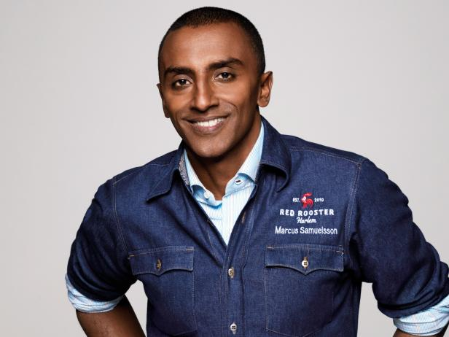
Marcus Samuelsson
This award-winning cookbook author is also an entrepreneur, media celebrity and one of the most famous chefs in the world. Marcus Samuelsson became an executive chef in New York at 24 and the youngest ever to receive a three-star restaurant review from The New York Times. As a food activist, he uses food, culture and history to spotlight Black cooking throughout the United States and the diaspora.

Slide 3
Mariya Russell
Mariya Russel has also broken barriers in the culinary world. In 2019, she was the first Black female chef to receive a Michelin star at Chicago’s Kikkō. Russel is also currently working on launching a site that will teach children and adults how to cook.

Slide 4
Edna Lewis
Known as the grande dame of southern cooking, Edna Lewis was among the first African American women from the South to pen a cookbook that did not hide the author's true name, gender or race, according to the National Women's History Museum. Lewis spent more than 75 years in the culinary world, where she was hailed as an esteemed chef in many popular restaurants, published three highly acclaimed cookbooks and won multiple James Beard awards.

Slide 5
“Black Forager” Alexis Nicole Nelson
James Beard Award winner Alexis Nicole, known on social media as “Black Forager” has made her presence known teaching everyone how to eat for free! Her videos have garnered the attention of millions, teaching people how to safely identify and prepare wild foods. She has also helped bring to light some of the historical racial disparity that goes along with foraging from it’s roots in slavery to racially biased trespassing laws.

Slide 6
Leah Chase
Leah Chase, also known as the Queen of Creole Cuisine, was the executive chef and co-owner of the Dooky Chase's Restaurant in New Orleans, one of the most historic restaurants in America. Chase was an acclaimed cookbook author and appeared on cooking shows with nationally recognized chefs, including Julia Child. She was awarded for both her work as a chef and in public service. When African Americans were denied a seat in New Orleans restaurants in the '50s and '60s, she cooked for them and fed meals to civil rights workers on the frontlines.

Slide 7
Patrick Clark
Patrick Clark was the first black chef to win a James Beard best chef award, which he took home for the mid-Atlantic region in 1994. Following this massive accomplishment, Clark was offered the position of executive chef at Tavern on the Green, one of the country's most successful restaurants at the time. Clark then took over the kitchen of Washington, D.C.'s prestigious Hay-Adams Hotel, which led to him later catering meals at the White House.

Slide 8
Robert W. Lee
So many Black chefs stand on the shoulders of Robert W. Lee. He started cooking at 7 and refined his skills in some of the best hotels in Florida, Georgia and South Carolina. A wealthy chef benefactor brought Lee to Harrisburg, Pennsylvania in 1939 to be executive chef at the Harrisburger Hotel. There, he created the menus and trained hundreds of Black chefs. During WWII, Lee received a medal from FDR for teaching so many troops to cook in his role as mess sergeant and instructor.

Slide 9
Nicole A. Taylor
James Beard-nominated food writer, master home cook and producer Nicole A. Taylor has written multiple books, been featured in publications like The New York Times and Food & Wine, and sits on the advisory board of Equity at the Table, an organization focused on bringing about equity in the food industry. Her latest release, Watermelon and Red Birds, focuses on the traditions surrounding Juneteenth and swerves from tradition by focusing on ingredients found on the traditional Black family’s table rather than dishes such as mac and cheese or sweet potato pie.

Slide 10
Larry and Jereline Bethune
The Bethunes opened their restaurant in Montgomery, Alabama in 1942. “Brenda’s” became a pivotal location in the civil rights movement of the 1960’s. Not only did the staff feed protestors, but the Bethunes allowed their restaurant to become a meeting place to organize and to hold NAACP meetings. They even used their copy machine to make flyers for protests. Jereline Bethune also helped teach other black residents of Montgomery to read so that they could pass the reading test to vote that had been imposed by Jim Crowe. The restaurant is still in operation and owned by their son, Larry Bethune, and his daughter, Donetta Bethune.

