Slide 1
Literary Devices – Part 1
Fleming 11/17/2022

Slide 2
onomatopoeia

Slide 3
onomatopoeia

Slide 4
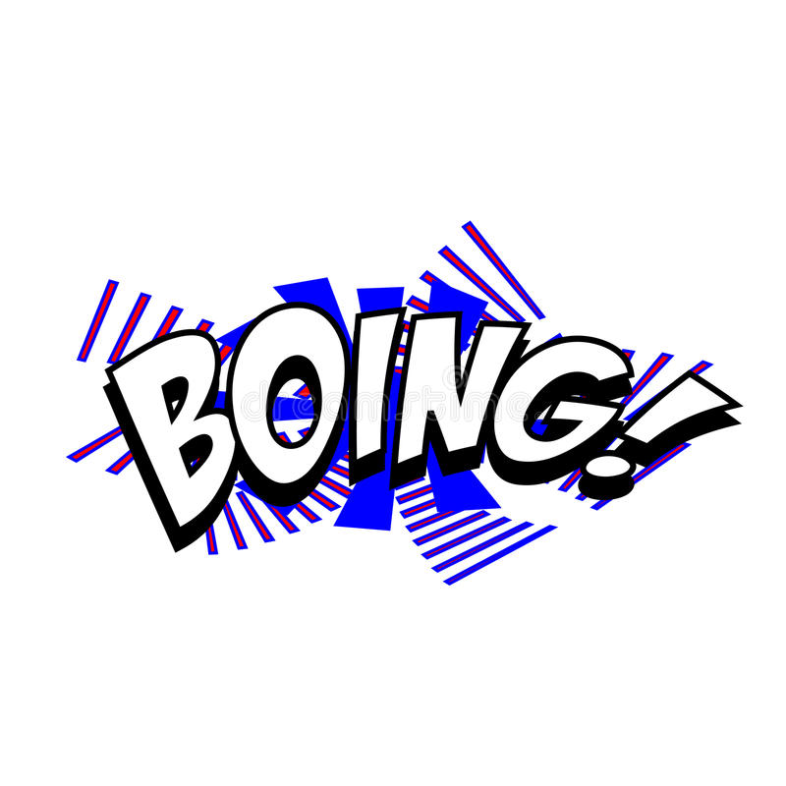
Onomatopoeia
the formation of a word from a sound associated with what is named (e.g. cuckoo, sizzle ).
the use of onomatopoeia for rhetorical effect.
boing, gargle, clap, zap, and pitter-patter

Slide 5
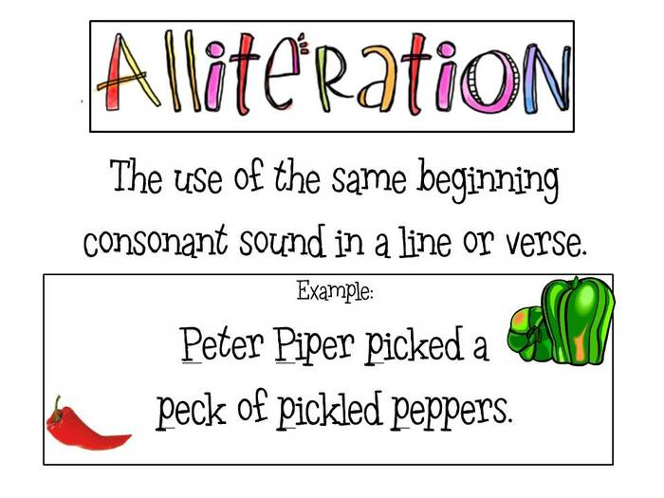
Alliteration
the occurrence of the same letter or sound at the beginning of adjacent or closely connected words.
“sweet birds sang”"

Slide 6
Repetition

Slide 7
Metaphor

Slide 8
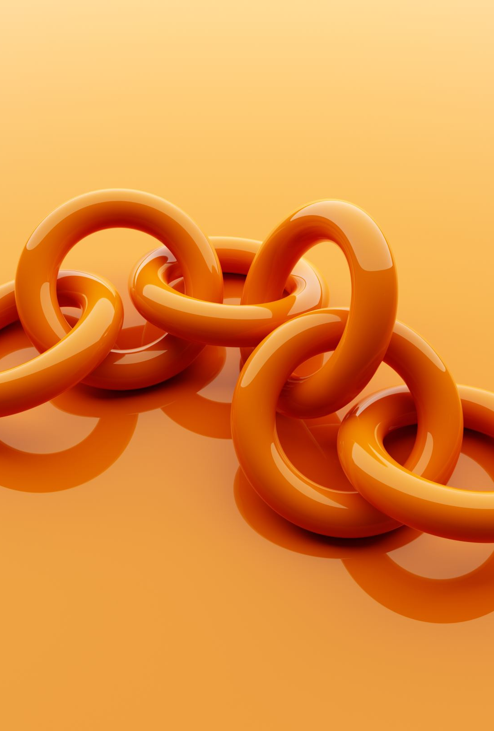
Simile
Comparison made between two objects using like or as
Very naturally; without effort. She started skating and learned quickly, like a duck takes to water.

Slide 10
Personification is giving human characteristic to inanimate objects.

Slide 11
Rhyme

Slide 12
Rhyme scheme

Slide 13
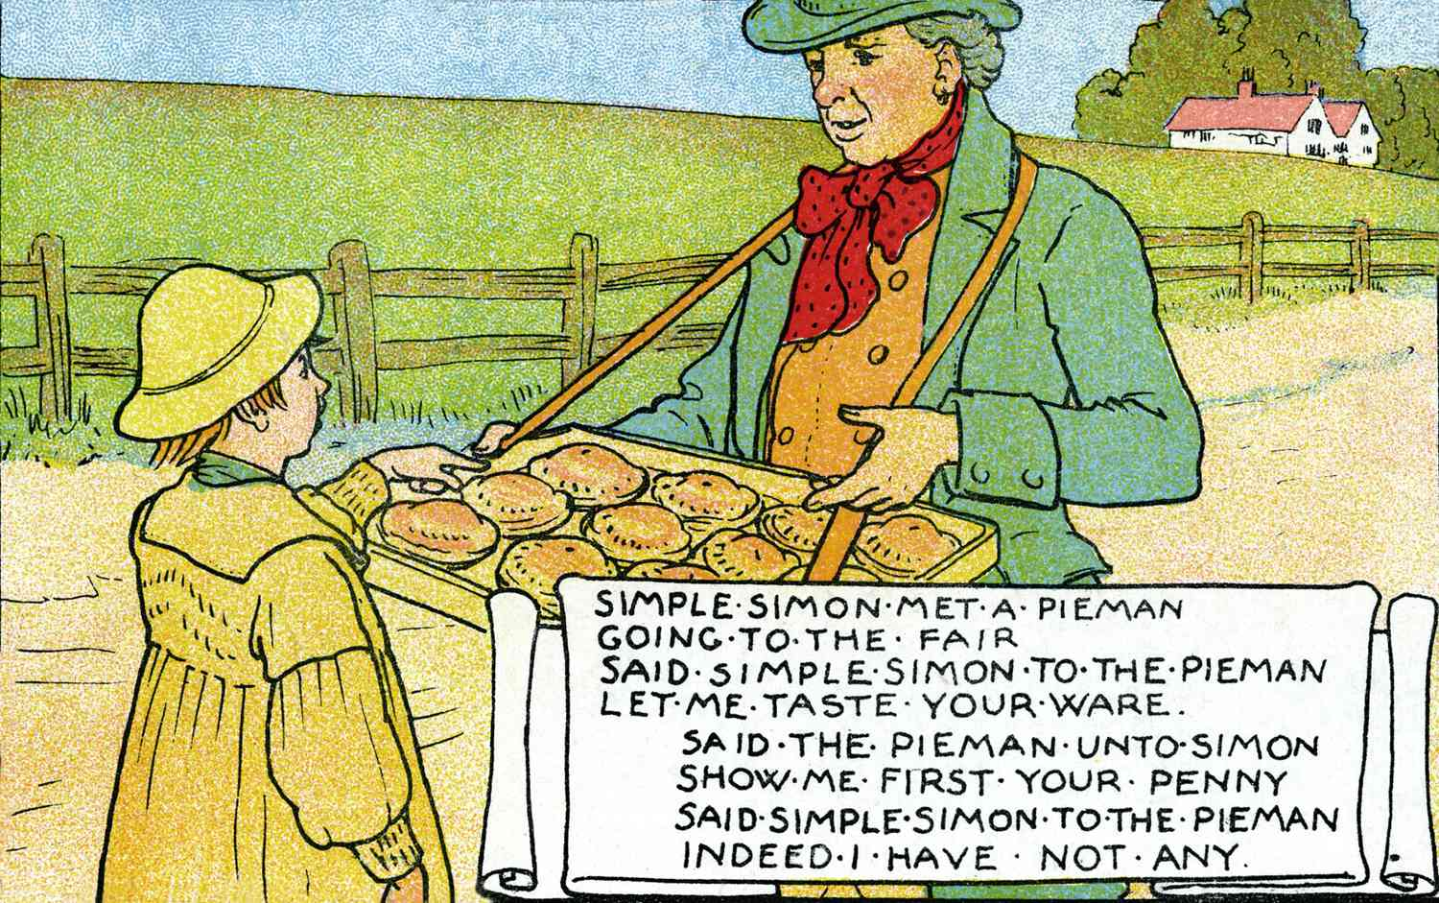
Rhythm

Slide 14
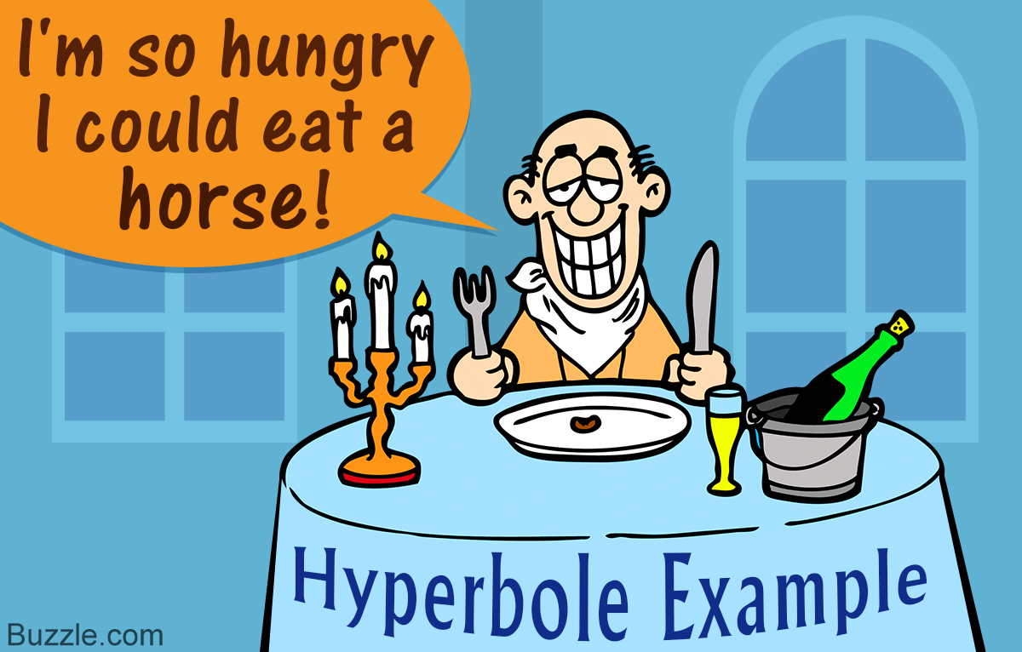
Hyperbole

Slide 15
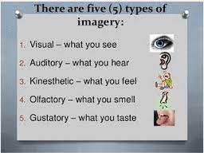
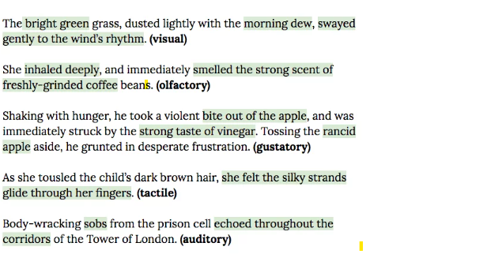
Imagery

Slide 16
Sensory Language

Slide 17
Figurative Language

Slide 18
Mood

Slide 21
Line-Break

Slide 22
Stanza

Slide 23
Genera

Slide 24
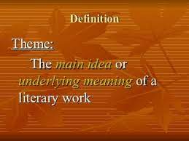
Theme

