Slide 1
Young Authors Prep
Fleming ’22

Slide 2
characters

Slide 3
Setting

Slide 4
Point of View

Slide 5
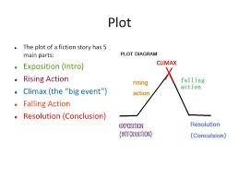
Plot

Slide 6
Theme

Slide 7
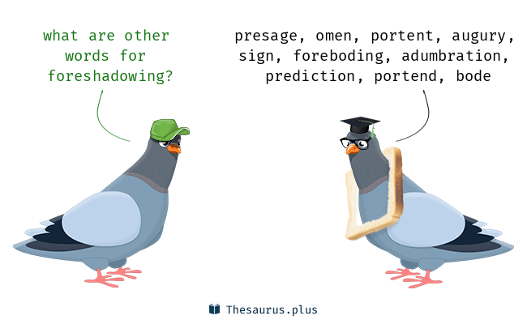
Foreshadowing

Slide 8
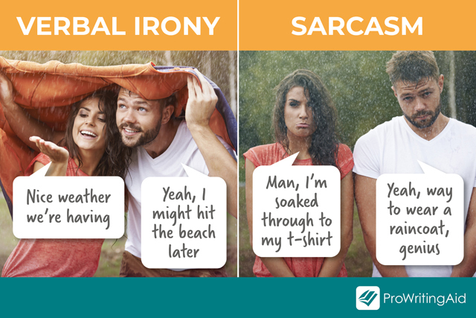
Irony

Slide 9
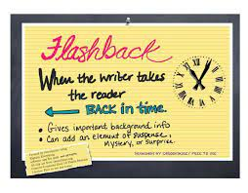
Flashback

Slide 10
Satire

Slide 11
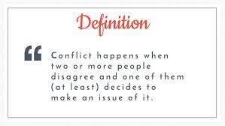
Conflict

Slide 12
Symbol

Slide 13
Allegory

Slide 14
Biography & Autobiography

Slide 15
Comedy & Tragedy

Slide 16
Mood

Slide 17
Tone

